Slide 1

🌍 PEARLS AQI Predictor
An Internship Project by Raviha Khan at 10Pearls Pakistan

Slide 2
PROJECT OVERVIEW
Building a Serverless AQI Prediction Pipeline
This project aimed to build a serverless AQI prediction system that forecasts air quality for the next 72 hours. For historic data, pollutants were collected from OpenMeteo and weather variables from WeatherAPI. For the hourly live fetch, data was collected directly from WeatherAPI (pollutants + weather). Since AQI was not provided by the API, it was computed using the EPA standard formula.
A feature engineering pipeline was created, and multiple models were tested, with Random Forest chosen as the best. The system was automated through GitHub Actions CI/CD, fetching data every hour, generating forecasts, and updating CSV files. A Streamlit dashboard was deployed to display the latest AQI snapshot and 72-hour forecast in real time.

Slide 3
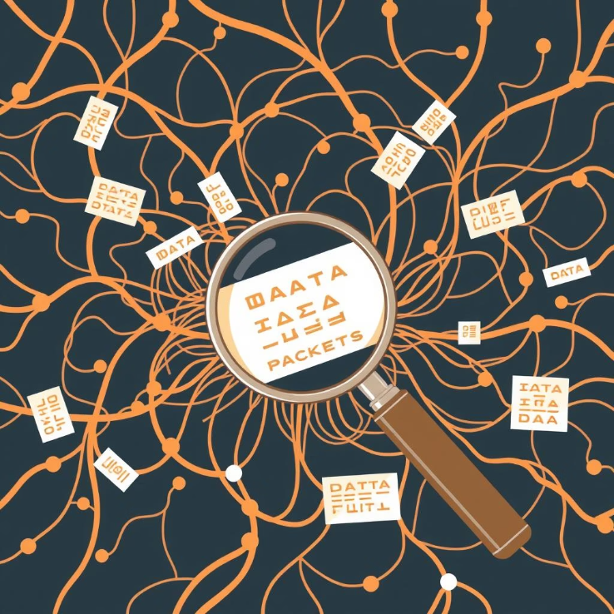
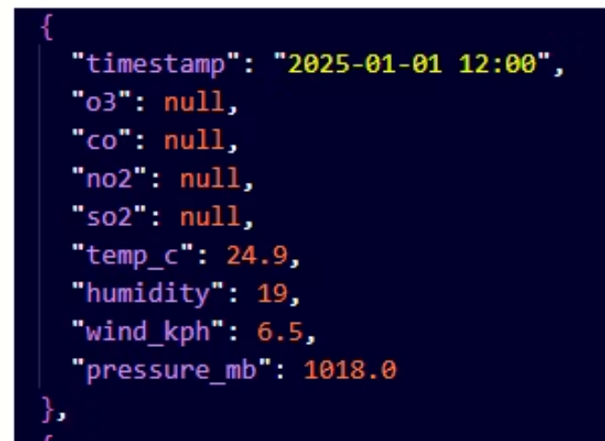
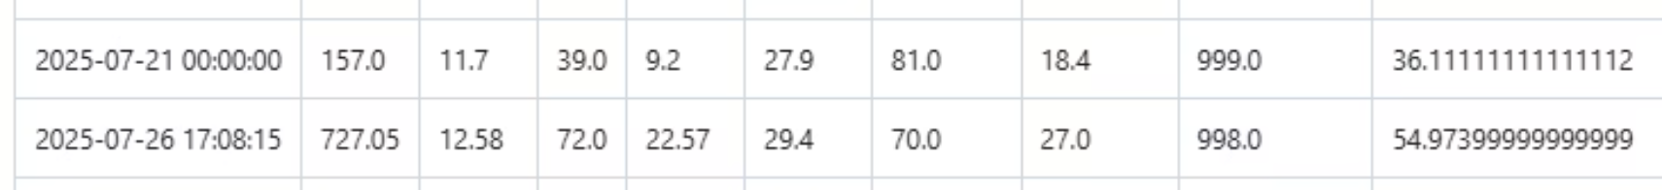
THE CHALLENGE
"Messy data, missing AQI, and my very first time with APIs & CI/CD deployment"
APIs gave only pollutants, not AQI
First-time hurdles:
WeatherAPI historic data → pollutants = null
Fetching live data from APIs
Data gap (21–26 July) when pipeline broke
Learning GitHub Actions for CI/CD automation
Had to calculate AQI manually using EPA formula
Deploying my first live ML app with Streamlit
Handling incomplete history (API limit: 3 months)
Preprocessing time-series (lags, rolling features)
.pkl files unreadable in VS Code → confusion
Poor early-Aug predictions (model unseen trends)

Slide 4
DATA ACQUISITION
Navigating Data Sources
Initial Attempt → OpenWeather API
Historic Data Challenge
Provided pollutants in AQI categories (1, 2, 3, 4, 5)
WeatherAPI free plan → only 3 months history available
Not suitable since this is a regression problem (needs continuous values)
Some pollutant values came as null
Switched to OpenMeteo for pollutants (CO, NO₂, O₃, SO₂)
Retained WeatherAPI for weather vars (temp, humidity, wind, pressure)
1
2
3
4
Switch to WeatherAPI (Hourly Fetch)
Final Historic Dataset
Collected pollutants + weather variables
Collected 1 April – 21 July 2025
AQI not included → had to calculate manually using EPA formula
Data gap: 21 July – 26 July (partial) due to pipeline stop
Merged & cleaned both sources by timestamp using clean_and_merge_data.py
PM2.5 and PM10 excluded (per project scope)
Result = continuous dataset ready for feature engineering

Slide 5
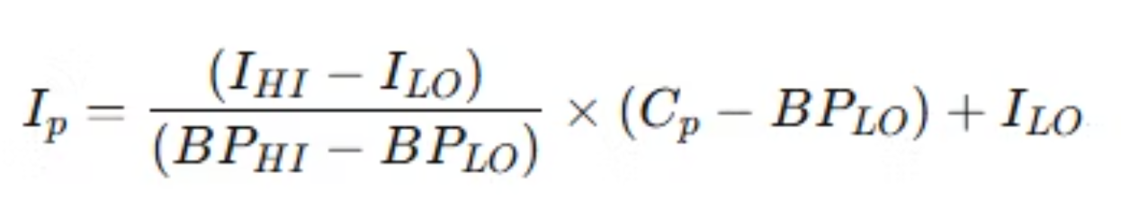
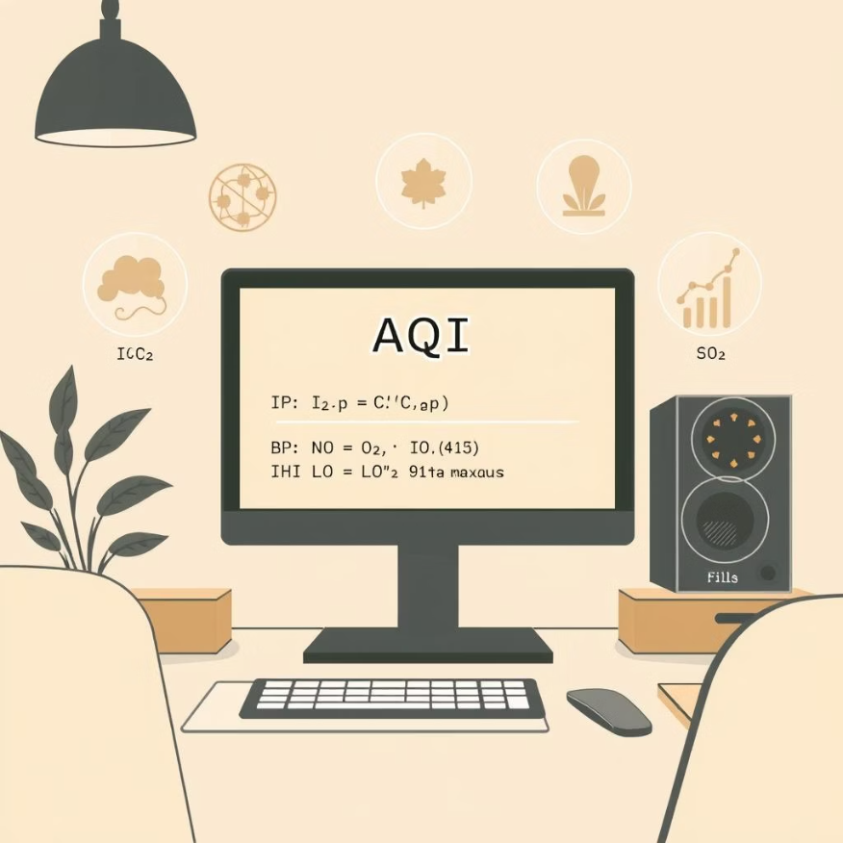
CORE CALCULATION
Deriving the Air Quality Index
"Deriving the Air Quality Index (AQI)"
Problem: APIs did not provide AQI directly
Outcome:
Solution: Manually calculated AQI using the US EPA formula
Built a complete and continuous AQI target column
Ensured data was ready for predictive modeling
Steps:
Compute a sub-index for each pollutant (CO, NO₂, O₃, SO₂)
Determine the final AQI = maximum sub-index
Filled missing AQI values with calculated results

Slide 6



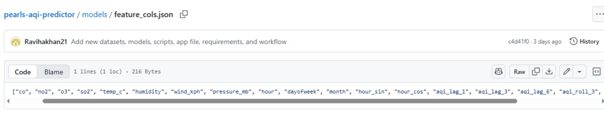
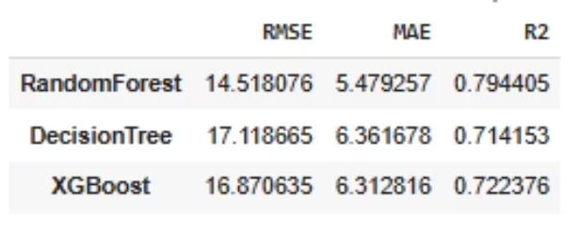
MODEL DEVELOPMENT
Feature Engineering & Training
Feature Engineering
Model Selection
Performance Metrics
Incorporated time-based features like lags and rolling averages to capture temporal dependencies.
We evaluated three regression models: Random Forest, XGBoost, and Decision Tree.
Model performance was rigorously assessed using standard regression metrics: RMSE (Root Mean Squared Error), MAE (Mean Absolute Error), and R² (Coefficient of Determination).
Introduced cyclical time features (e.g., sin/cos transformations for hour/day) to account for periodic patterns.
Random Forest consistently outperformed others and was selected as the final model due to its robustness and accuracy.

Slide 7
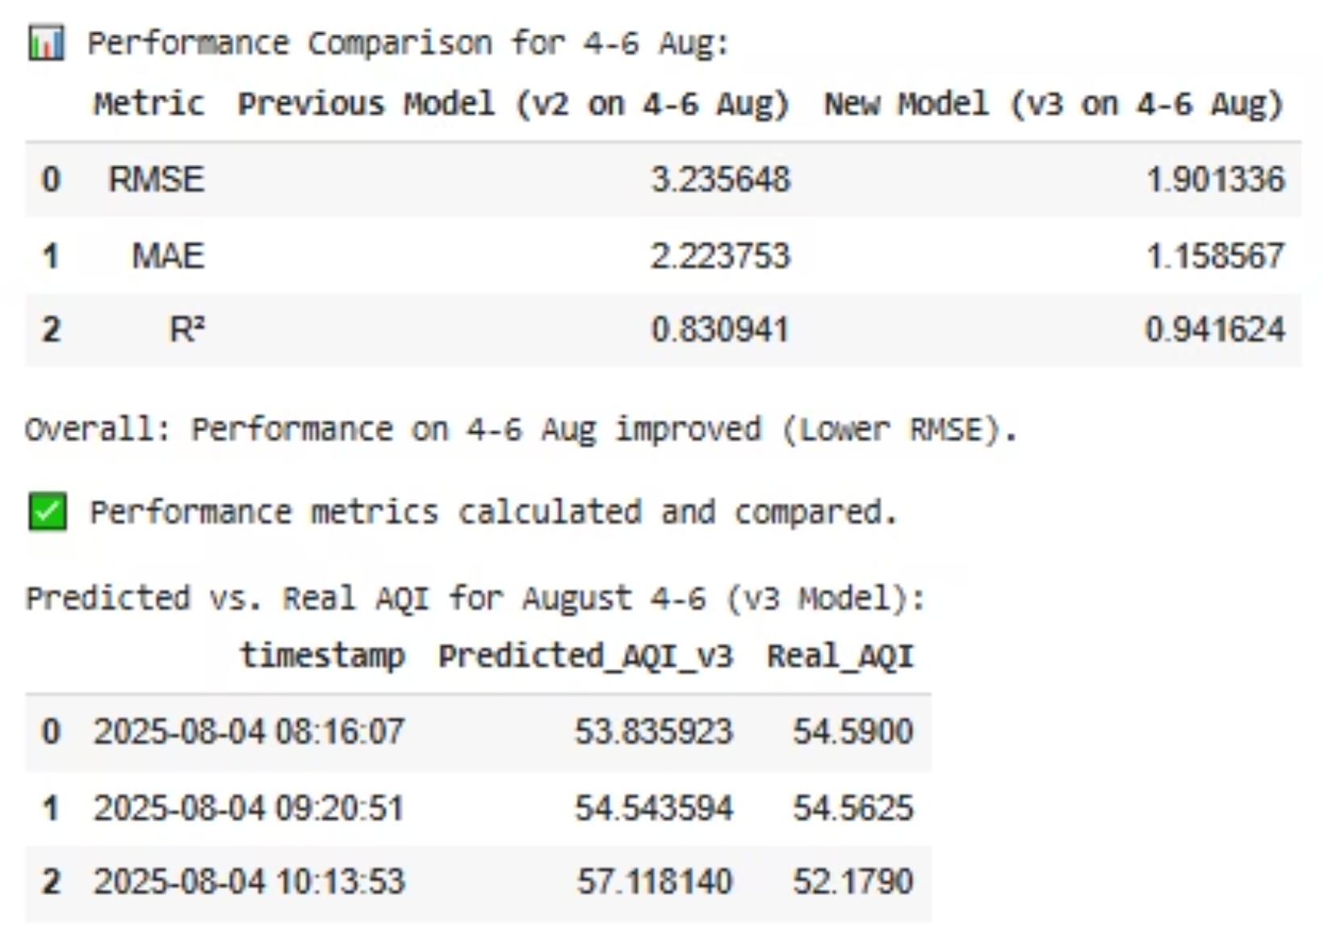
PREDICTION REFINEMENT
"Improving predictions with better training data"
Step 1: Using Dataset v2
Trained and tested model on final_training_dataset_v2.csv (April–31 July)
Predicted 1–3 Aug (pollutants_1_3_aug.csv) and forecasted 4–6 Aug (pollutants_4_6_aug.csv)
Compared results with real AQI (real_aqi_1_3_aug.csv, real_aqi_4_6_aug.csv)
Problem:
Forecast for 4–6 Aug was poor → model had not seen August trends
Step 2: Creating Dataset v3
Built final_training_dataset_v3.csv (April–3 Aug)
Retrained and re-evaluated the model
Forecast for 4–6 Aug improved significantly
Key Takeaway:
Adding the latest available data improved model performance
Shows importance of keeping the training set updated for time-series forecasting

Slide 8



OPERATIONAL EXCELLENCE
How our pipeline runs automatically
1. Data Fetching
2. Data Cleaning & Preprocessing
4. Prediction & Storage
Source: Pollutants and weather data are fetched from APIs every hour.
Script: clean_aqi_json_v2.py
Script: predict_live.py
Tasks:
Tasks:
File: aqi_data.json stores the raw API responses.
Convert raw JSON into a clean hourly dataset (hourly_clean_updated.csv).
Load hourly_clean_updated.csv
Apply feature engineering (feature_engineering_pipeline).
Automation: GitHub Actions workflow (fetch_aqi.yml) runs hourly via a cron job.
Handle missing values, ensure numeric consistency.
Forecast AQI for 72 hours autoregressively:
Compute initial AQI using a deterministic formula.
Use last observed data for base features.
Compute rolling/lag features for each forecast step.
Feed predictions back into dataset for next-step calculation.
Save results in predictions_72h.csv.
This entire workflow is orchestrated by a GitHub Actions cron job, running every hour. This ensures 100% serverless automation of the entire AQI prediction pipeline, from data ingestion to forecast delivery.

Slide 9
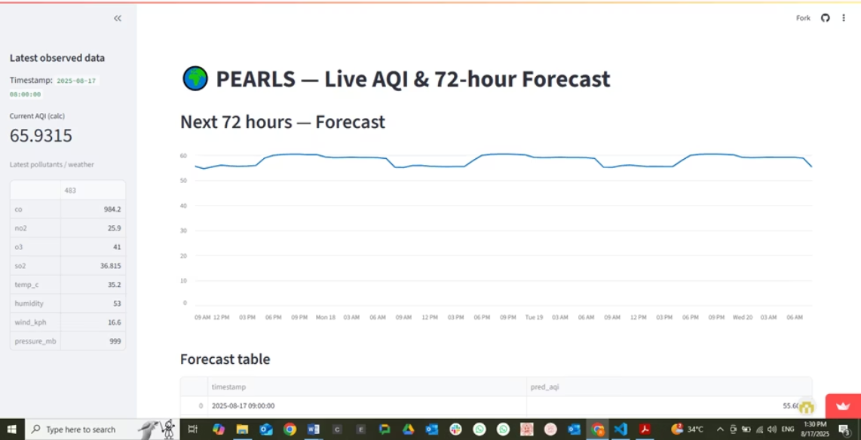
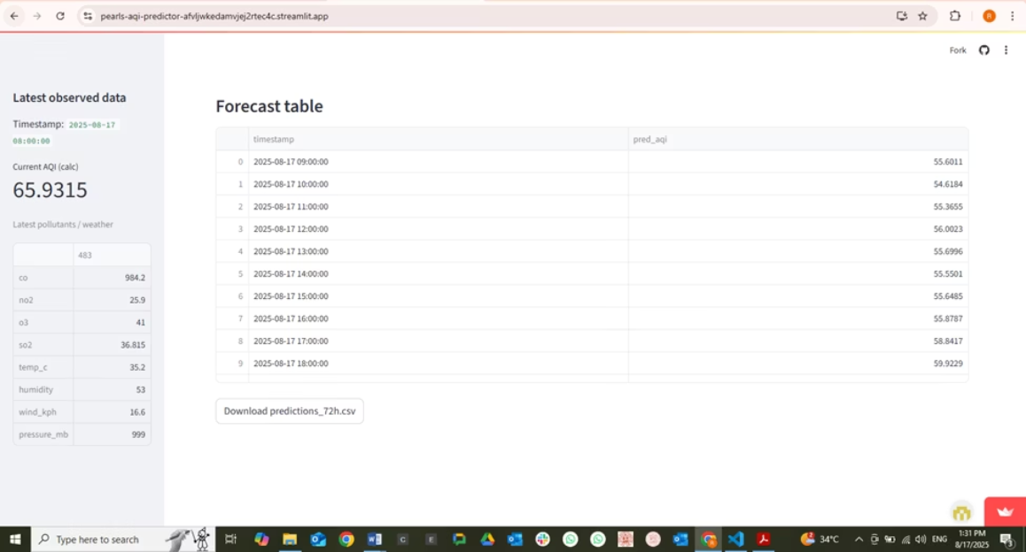
USER INTERFACE
Streamlit Dashboard
The Streamlit dashboard serves as the user-facing interface for the AQI predictor. It offers a clear, concise view of:
A real-time current AQI snapshot.
A visual 72-hour forecast presented as both a chart and a detailed table.
Convenient CSV download option for raw prediction data.
Explore the live dashboard: PEARLS AQI Dashboard
Dashboard link:
https://pearls-aqi-predictor-afvljwkedamvjej2rtec4c.streamlit.app/

Slide 10



CONCLUSION
Key Learnings & Milestones
Data Mastery
CI/CD & Serverless
End-to-End Project
Gained profound experience in complex data cleaning, transformation, and preparation of datasets, including the intricate calculation of the Air Quality Index (AQI). Additionally, handled live hourly data fetching from APIs, ensuring real-time ingestion and processing for accurate forecasting.
Developed practical skills in Continuous Integration/Continuous Deployment (CI/CD) pipelines using GitHub Workflows and serverless deployment.
Successfully executed my first complete end-to-end data science project, significantly boosting confidence in my ability to deliver production-ready solutions.
My internship with 10Pearls Pakistan has been a truly memorable milestone 🎯, providing invaluable hands-on experience and mentorship.This was my very first time working on a complete data science project from start to finish. At the beginning, I had very little experience beyond my AI lab course, but this project pushed me into real-world workflows like data collection, feature engineering, model training, and deployment. Along the way, I also learned how to use GitHub CI/CD pipelines and set up a serverless automation system for hourly AQI prediction. It was a journey full of trial and error, but also full of growth. In the end, I successfully built a working AQI prediction system, and this made the whole experience with 10Pearls Pakistan not just a technical achievement, but also a very memorable milestone in my learning journey.

